Slide 1
ENGLISH FOR IT
LO 4 - VOCABULARY
The Internet, e-mail, networks, hosting and pricing models
I could repair the roof myself if I HAVE) a ladder.

Slide 2
In this lesson, you will:
Understand the difference between the Web and the Internet
Study vocabulary related to the Internet and email
Learn the vocabulary for computer networks
Study the web hosting and pricing models
Learn new IT initialisms

Slide 3
Discuss in pairs/groups
How would you define the Internet?
What is the difference between the Internet and the Web?
List all the things you can use the Internet and the Web for.
Notes:
The Internet (or Net) is a global network of computer networks, which allow organizations and individuals to share all sorts of information and computer resources
You can use the Internet to send and receive email, explore the Web, transfer files, have online conversations, take part in online forums, use remote computers.
You can use the Web to find, stream and download games, music or videos, to buy products online, to search for information etc.

Slide 4
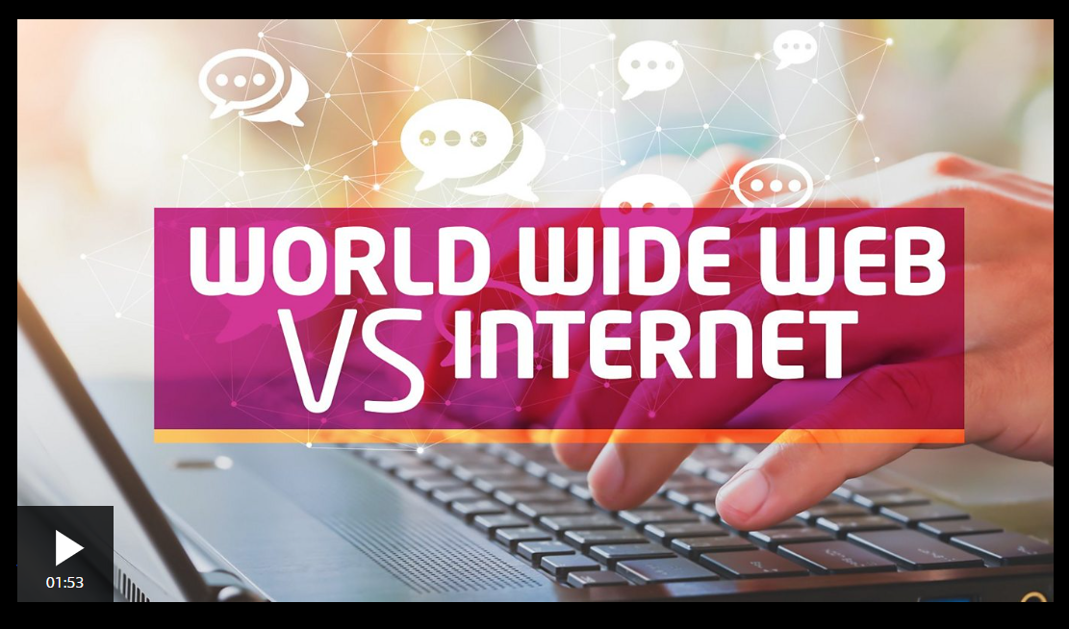
https://www.bbc.co.uk/newsround/av/47523993

Slide 5

Complete these notes in pairs.
Then, listen to the shop assistant explaining the customer about the Internet and check your answers.

Slide 7
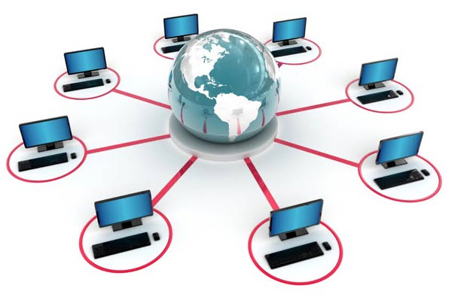

Slide 13

RSS (Really Simple Syndication)
Subscribing to RSS feeds can allow a user to keep track of many different websites in a single news aggregator, which constantly monitors sites for new content, removing the need for the user to manually check them. News aggregators (or "RSS readers") can be built into a browser, installed on a desktop computer, or installed on a mobile device.

Slide 14
Web hosting – read this web page and compare the plans

Slide 16
Definitions
IP ADDRESS
GUARANTEE
BANDWIDTH
DEDICATED HOSTING
MINIMUM
UPTIME

Slide 18
Pricing models

Slide 19
Initialisms
WWW
ISP
URL
ATM
PIN
LAN
WAN
CC
BCC
HTTP
FTP
RSS
SaaS

Slide 20
More vocabulary practice
3.1 The Internet: the basics (pp 50-51);
3.2 Internet browsers (p 52);
3.3 Search engines (p 53)

Slide 21
Resources:
Remacha: Infotech
Hill: English for IT 2 (Units 3 and 5)
Marks: Vocabulary Book – 3.1 The Internet: the basics (pp 50-51); 3.2 Internet browsers (p 52); 3.3 Search engines (p 53)
https://www.bbc.co.uk/newsround/av/47523993

Slide 22
#neverstoplearning

