Slide 1
ENGLISH FOR IT
LO1 VOCABULARY
Basic software – the operating system

Slide 2
Today you will:
Learn about the function of the operating system
Revise some features of graphical user interface (GUI)
Learn the vocabulary related to reinstalling OS
Compare and discuss Mobile OS
Compare and discuss open source and proprietary software

Slide 3
The Operating System

Slide 4
In pairs, discuss these questions
What operating systems can you name? What versions of these operating systems do you know?
Which operating systems do you use most often?
Which is your favourite? Why?
Have you ever installed an operating system by yourself? Was it easy or difficult?

Slide 5
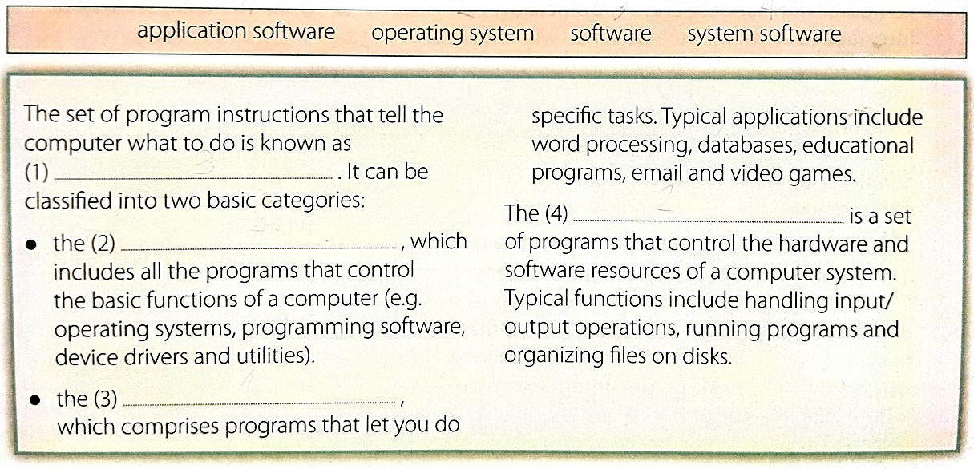

Slide 6
Check your answers
(1) software
(2) system software
(3) application software
(4) operating system

Slide 7
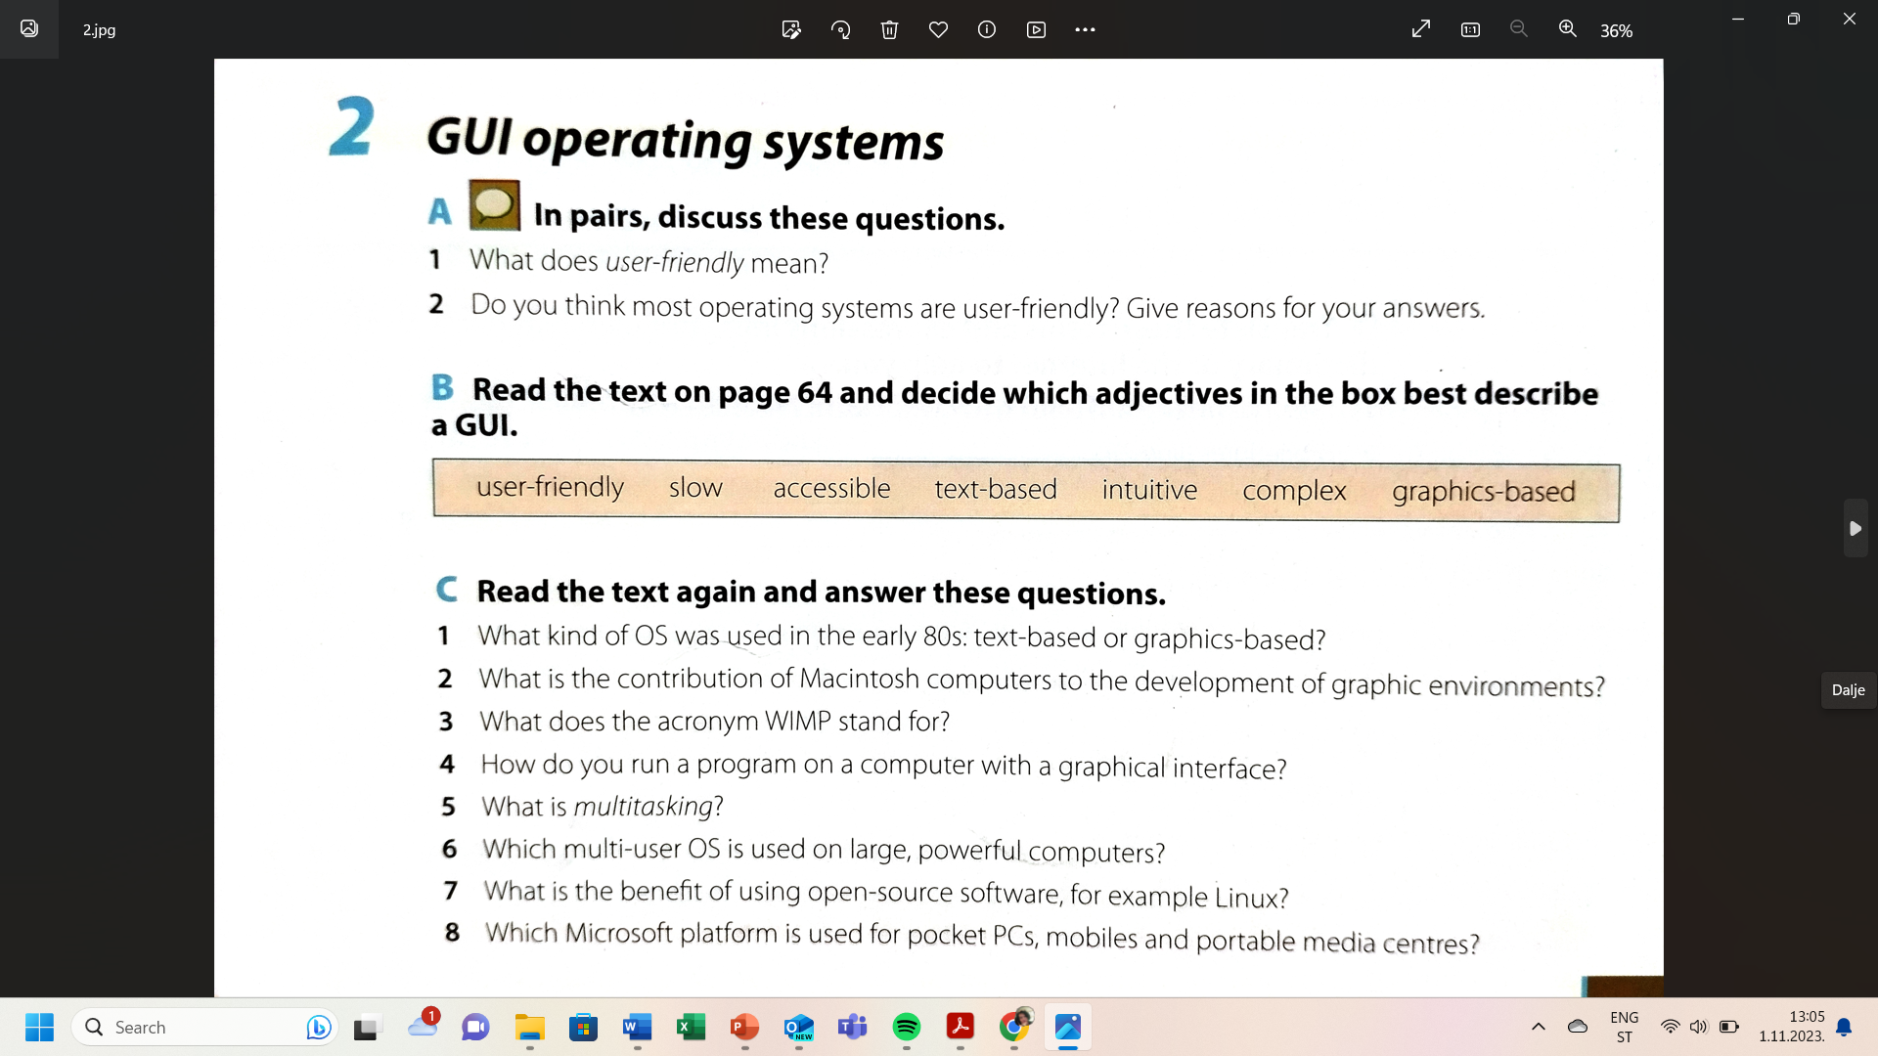
What do you know about OS? Discuss in pairs/groups and then check with your teacher.

Slide 8
Check your answers
Text-based.
The Macintosh was the first computer that used a mouse and a GUI (graphical user interface).
WIMP stands for windows, icons, menus and pointer.
By double-clicking the program icon or a document icon.
Running several programs and doing various tasks at the same time.
Unix.
Open-source software like Linux is freely distributed – i.e. you can copy, change and redistribute its code.
Windows Mobile.

Slide 9
GUI
(graphical user interface)

Slide 10
Graphical user interface (GUI) is a computer program that enables a person to communicate with a computer through the use of symbols, visual metaphors, and pointing devices.
Which adjectives would you use to describe it?
GUI is pronounced “gooey” ☺
Notes:
ANSWERS: user-friendly, accessible, intuitive, graphics-based

Slide 11
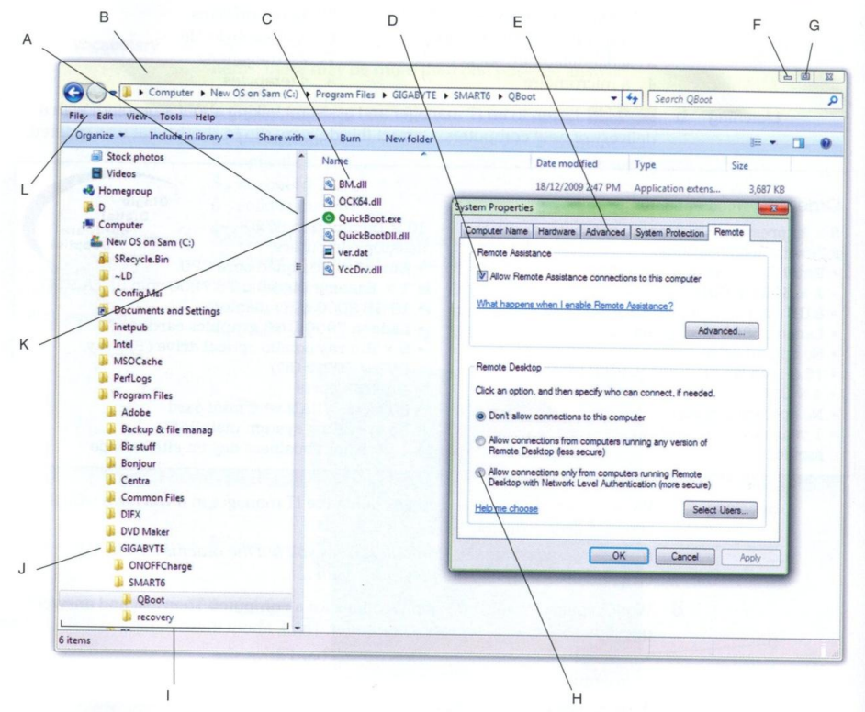
Match the words to A-L in the screenshot:
Scroll bar
Menu
Minimize button
Maximize button
Title bar
Icon
Folder
Filename
Left-hand pane
Tab
Check box
Radio button
Notes:
GUI – Windows 7

Slide 12
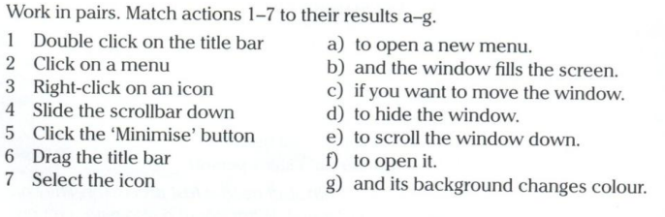
GUI operations

Slide 13


Check your answers
GUI VOCABULARY, SLIDE 11
GUI OPERATIONS, SLIDE 12

Slide 14
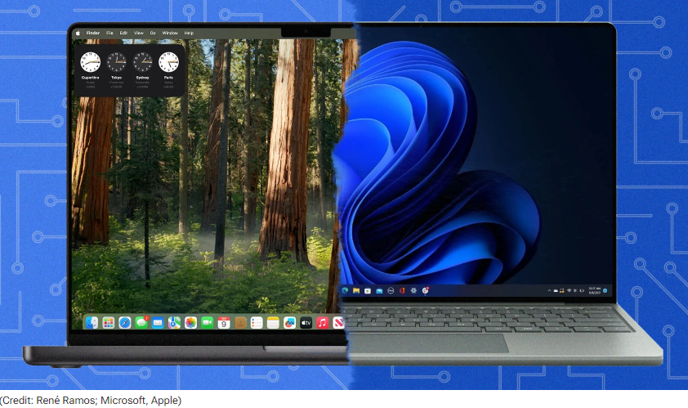
Discuss in pairs or groups
Compare the Mac OS user interface with a Windows interface. What are the similarities and differences? Which features do you prefer from each interface?
Find out more here:
https://www.pcmag.com/news/macos-vs-windows-which-os-really-is-the-best

Slide 15
Reinstalling an Operating System

Slide 16
Reinstalling an OS

Slide 17
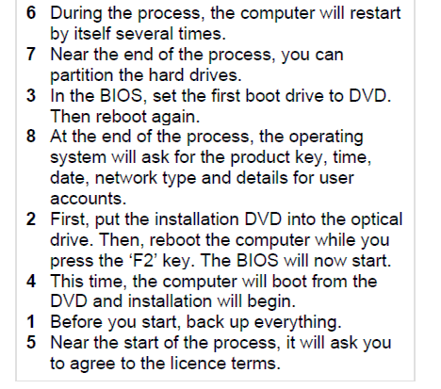
Check your answers

Slide 19
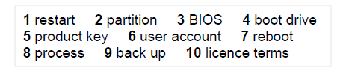
Check your answers

Slide 20
Mobile OS

Slide 21
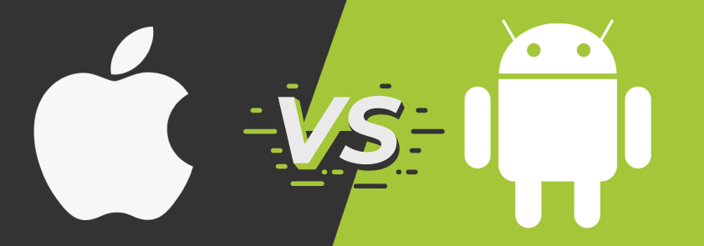
Which companies developed iOS / Android OS?
What does iOS stand for?
When was the first version of iOS / Android launched?
What is the most recent version of iOS?
What’s the name of iOS’s voice-enabled personal assistant?
Which mobile OS is more popular/ has more market shares?
Which source code is released in an open-souce format (the Android OS or iOS)?

Slide 22
iOS – Apple / Android OS - Android Inc., a software company located in Silicon Valley , acquired by Google in 2005.
It's an acronym for iPhone Operating System.
The first version of iOS, launched with the first iPhone in 2007, whereas Google announced its first commercially available Android-powered device in 2007, although that product actually hit the marketplace in 2008.
The company is releasing iOS 18 in the fall of 2024
Siri – first introduced in iOS 5
Apple iOS is the second-most popular mobile operating system. According to Statecounter.com, as of July 2024, Apple iOS held a 27% share of the mobile operating system market, second only to Android which held a 71% market share
The Android source code is released in an open-source format to help advance open standards across mobile devices. However, despite being released as “open,” Android is still packaged with proprietary software when sold on handset devices.

Slide 23
Open source vs proprietary software

Slide 24
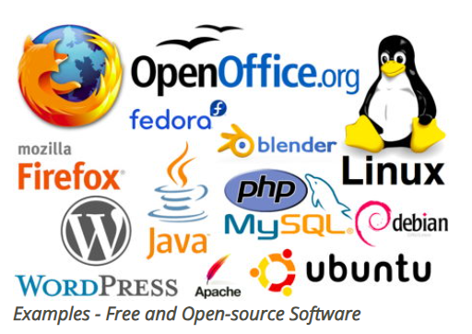
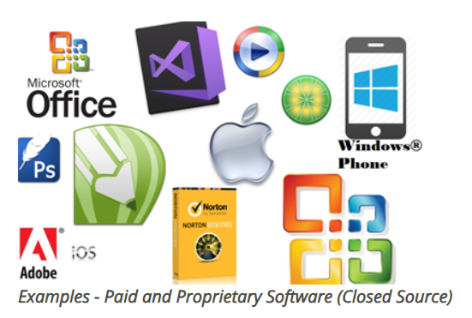
Open source vs. proprietary software

Slide 25
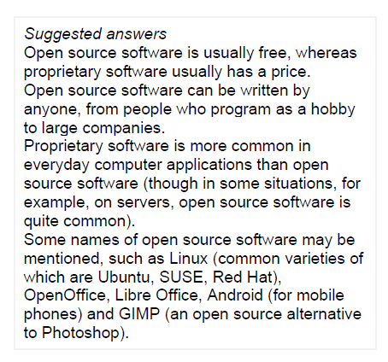
Check your answers

Slide 26
Read this web article about open source software

Slide 27
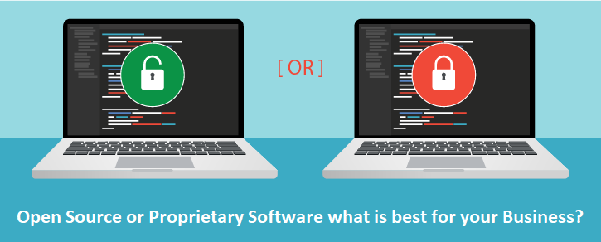


Slide 28
Check your answers
The PROs of proprietary and open source software
Proprietary software | Open source software
cheaper training and free support better quality: more features, better looking, fewer bugs (because they pay their developers) more applications available | free freedom/independence from the vendor can add features have control over data
Notes:
Extra activity: Make a list of CONs for Proprietary and Open Source software in groups. Compare PROs and CONs and decide which type of software is better.

Slide 29
Resources:
Hill, English for Information Technology 2 - Unit 2
Remacha, Infotech – Unit 13
https://www.pcmag.com/news/macos-vs-windows-which-os-really-is-the-best
https://www.investopedia.com/terms/a/apple-ios.asp
https://www.investopedia.com/terms/a/android-operating-system.asp

Slide 30
#neverstoplearning

