Slide 1
Corporate strategy and structure

Slide 2
SWOT analysis
SWOT analysis is a planning process that helps your company overcome challenges and determine which new leads to pursue.
SWOT stands for strengths, weaknesses, opportunities and threats.

Slide 3
SWOT analysis
Let’s do a quick SWOT analysis for Algebra University!

Slide 4
SMART objectives
Objective-setting (goal-setting) is very important for a company. It means translating the high-level vision into specific, measurable goals.
These objectives should follow the SMART criteria—specific, measurable, achievable (attainable), relevant, and time-bound—to provide clear targets for each department.

Slide 5
SMART objectives

Slide 6
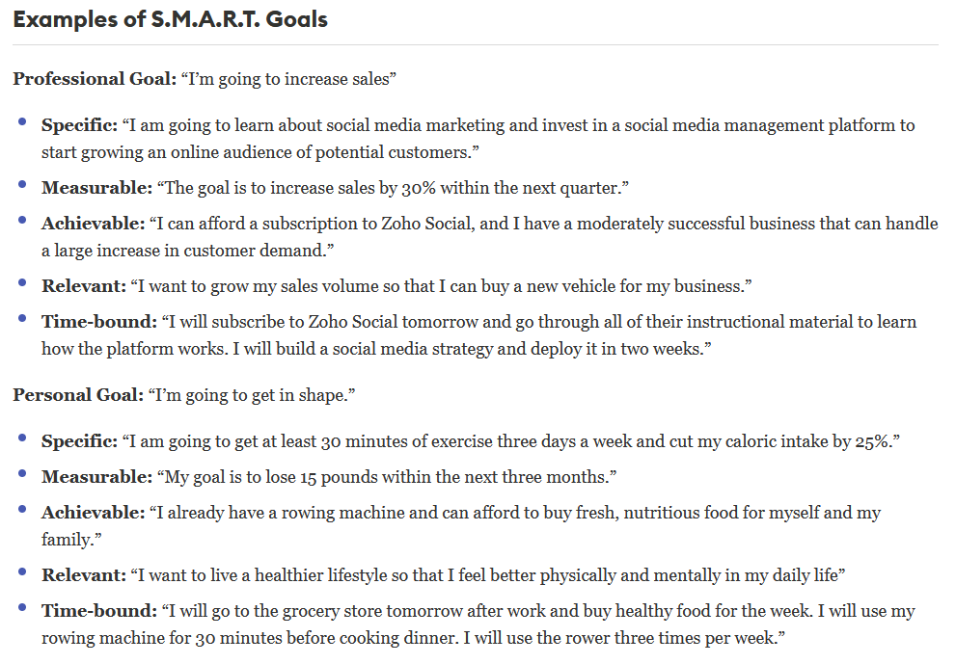
https://www.forbes.com/advisor/business/smart-goals/

Slide 7
Types of planning
Strategic planning concerns the longer term and the big picture. It is the process of defining the company’s mission, determining the overall goals of the organisation and allocating resources to reach those goals.
Operational planning concerns translating the general, long-term goals into more specific, concrete objectives. It involves monitoring the day-to-day work of departments. It is done by middle and supervisory managers.

Slide 8
Company structure
A business needs to organize itself into a structure that best suits its objectives. This can be done in several ways:
Organization by function. The company is divided into departments such as production, finance, marketing, human resources.
Organization by product. The company brings together staff who are involved in the same product line.
Organization by customer type. The company is organized around different sectors of the market. Large customers are called key accounts.
Organization by geographical area. The company is organized according to regions.

Slide 9
Centralization vs decentralization
A key issue for the company is to decide on the degree of centralization. Should authority be kept at Head Office (centralization)? If so, this would mean:
A strong corporate image
Decisions made by experienced managers who see the whole picture
Standardized procedures and simpler distribution channels

Slide 10
Centralization vs decentralization
But decentralization also has advantages:
Lower-level managers are more familiar with local conditions and can therefore give a stronger customer focus
The delegation of decision-making is likely to lead to a higher level of morale of employees.

Slide 11
Mission statement and vision statement
Mission statement: defines the company’s business, its objectives and its approach to reach those objectives. It focuses on today and what the organization does to achieve it.
Vision statement: describes the desired future position of the company. It focuses on tomorrow and what the organization wants to become.

Slide 12
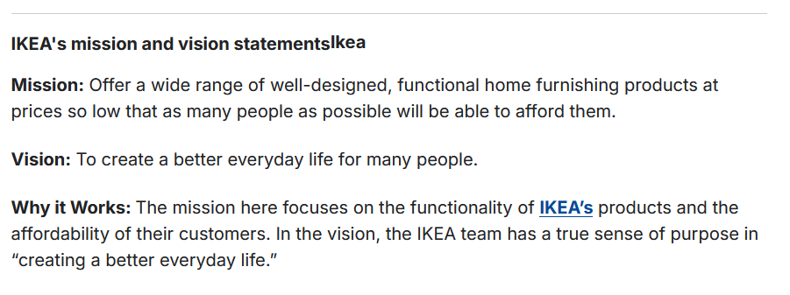
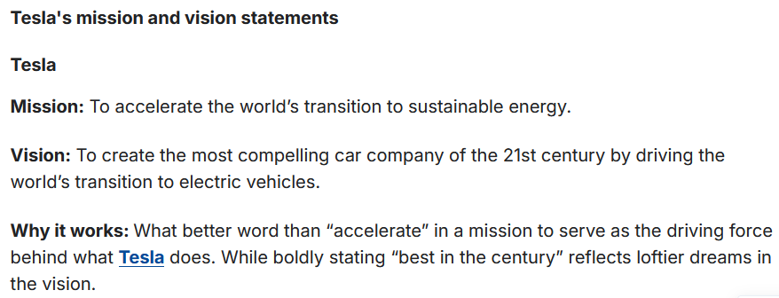
Mission statement and vision statement: examples
https://www.clearvoice.com/resources/difference-between-mission-vision-statement/

Slide 13
Corporate values
Company core values are the set of ethics and principles that govern a company’s decision making and actions. They also serve as the foundation for the company culture, and the behaviours expected by its workforce.
Example core values: integrity, honesty, loyalty, passion, trust, teamwork…

Slide 14
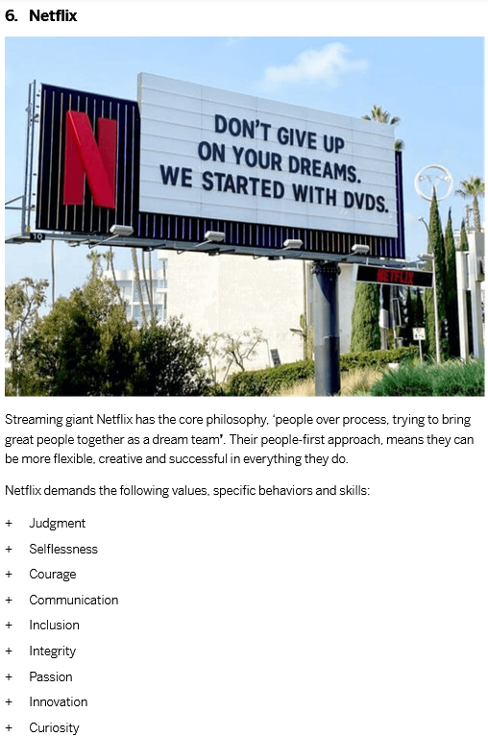
Corporate values: examples
Core values of famous companies: https://www.qualtrics.com/blog/company-core-values/

Slide 15
Vocabulary exercises

Slide 16
Terminology
Market research: using a questionnaire to carry out a survey
Core business: the main activity of a company that generates most of its profits
Shareholder value: financial benefits (=increase in share price and dividends) for the owners of the company
Product portfolio: the whole range of products that a company sells

Slide 17
Terminology
Brand loyalty: when customers are faithful to a particular product
Earnings growth: a continuing increase in profits
Management hierarchy: what is shown in an organigram (=organization chart)
Distribution channel: how a product gets from the manufacturer to the end-user

Slide 18
Sources
https://www.businessnewsdaily.com/4245-swot-analysis.html
https://www.clearvoice.com/resources/difference-between-mission-vision-statement/
https://www.achievers.com/blog/company-core-value-examples/
https://www.qualtrics.com/blog/company-core-values/
https://www.cascade.app/blog/corporate-strategy
https://www.forbes.com/advisor/business/smart-goals/
Emmerson, P. (2007): Business English Handbook Advanced, Macmillan
MacKenzie, I. (2010): English for Business Studies, 3rd ed., Cambridge

Slide 19
#neverstoplearning

